Slide 1
Chapter 8: More on the Repetition Structure

Slide 2
Objectives
Include a posttest loop in pseudocode
Include a posttest loop in a flowchart
Code a posttest loop using the C++ do while statement
Nest repetition structures

Slide 3
Posttest Loops
Repetition structures can be either pretest or posttest loops
Pretest loop – condition evaluated before instructions are processed
Posttest loop – condition evaluated after instructions are processed
Posttest loop’s instructions are always processed at least once
Pretest loop’s instructions may never be processed

Slide 4
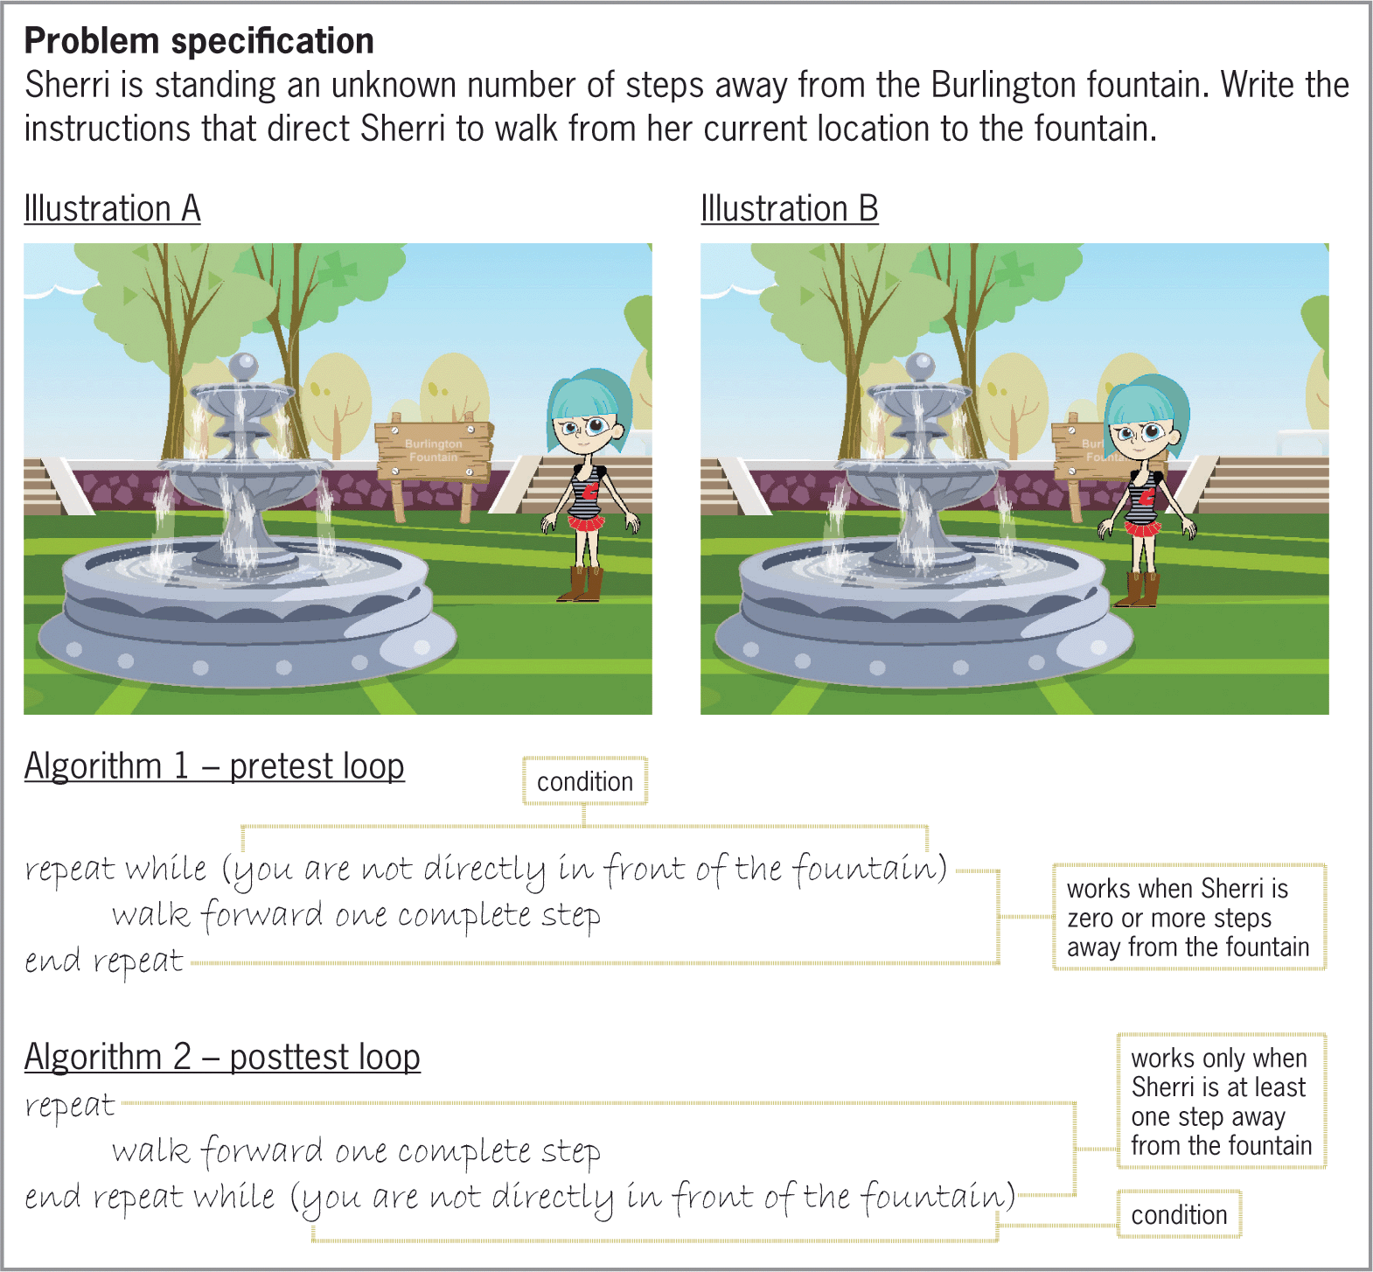
Posttest Loops (cont’d.)
Figure 8-1 Problem specification, illustrations, and solutions containing pretest and posttest loops

Slide 5
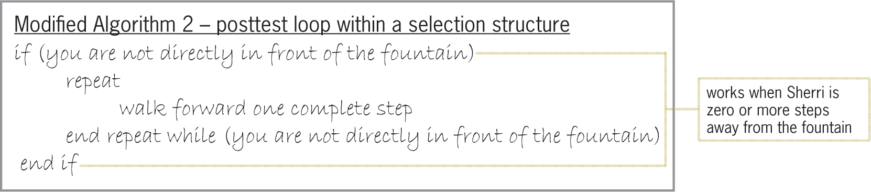
Posttest Loops (cont’d.)
Figure 8-2 Selection structure added to Solution 2 from Figure 8-1

Slide 6
Flowcharting a Posttest Loop
Decision symbol in a flowchart (a diamond) representing a repetition structure contains the loop condition
Decision symbol appears at the top of a pretest loop, but at the bottom of a posttest loop

Slide 7
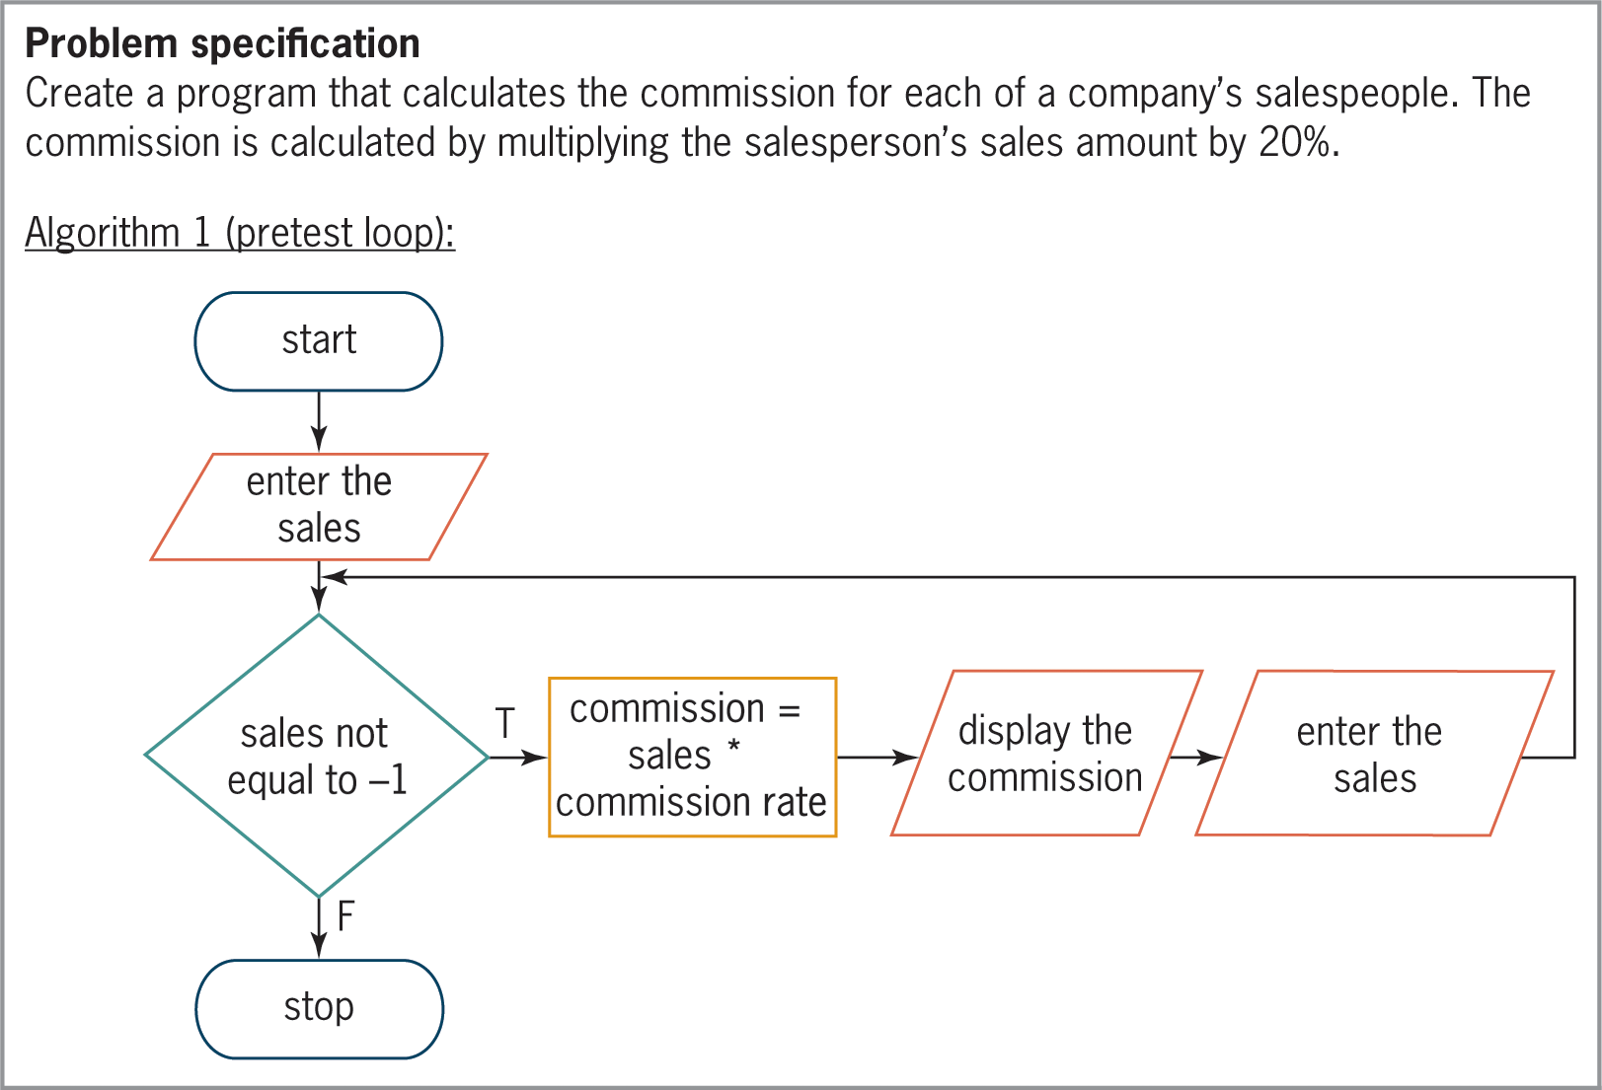
Flowcharting a Posttest Loop (cont’d.)
Figure 8-3 Commission Program’s problem specification and flowcharts

Slide 8
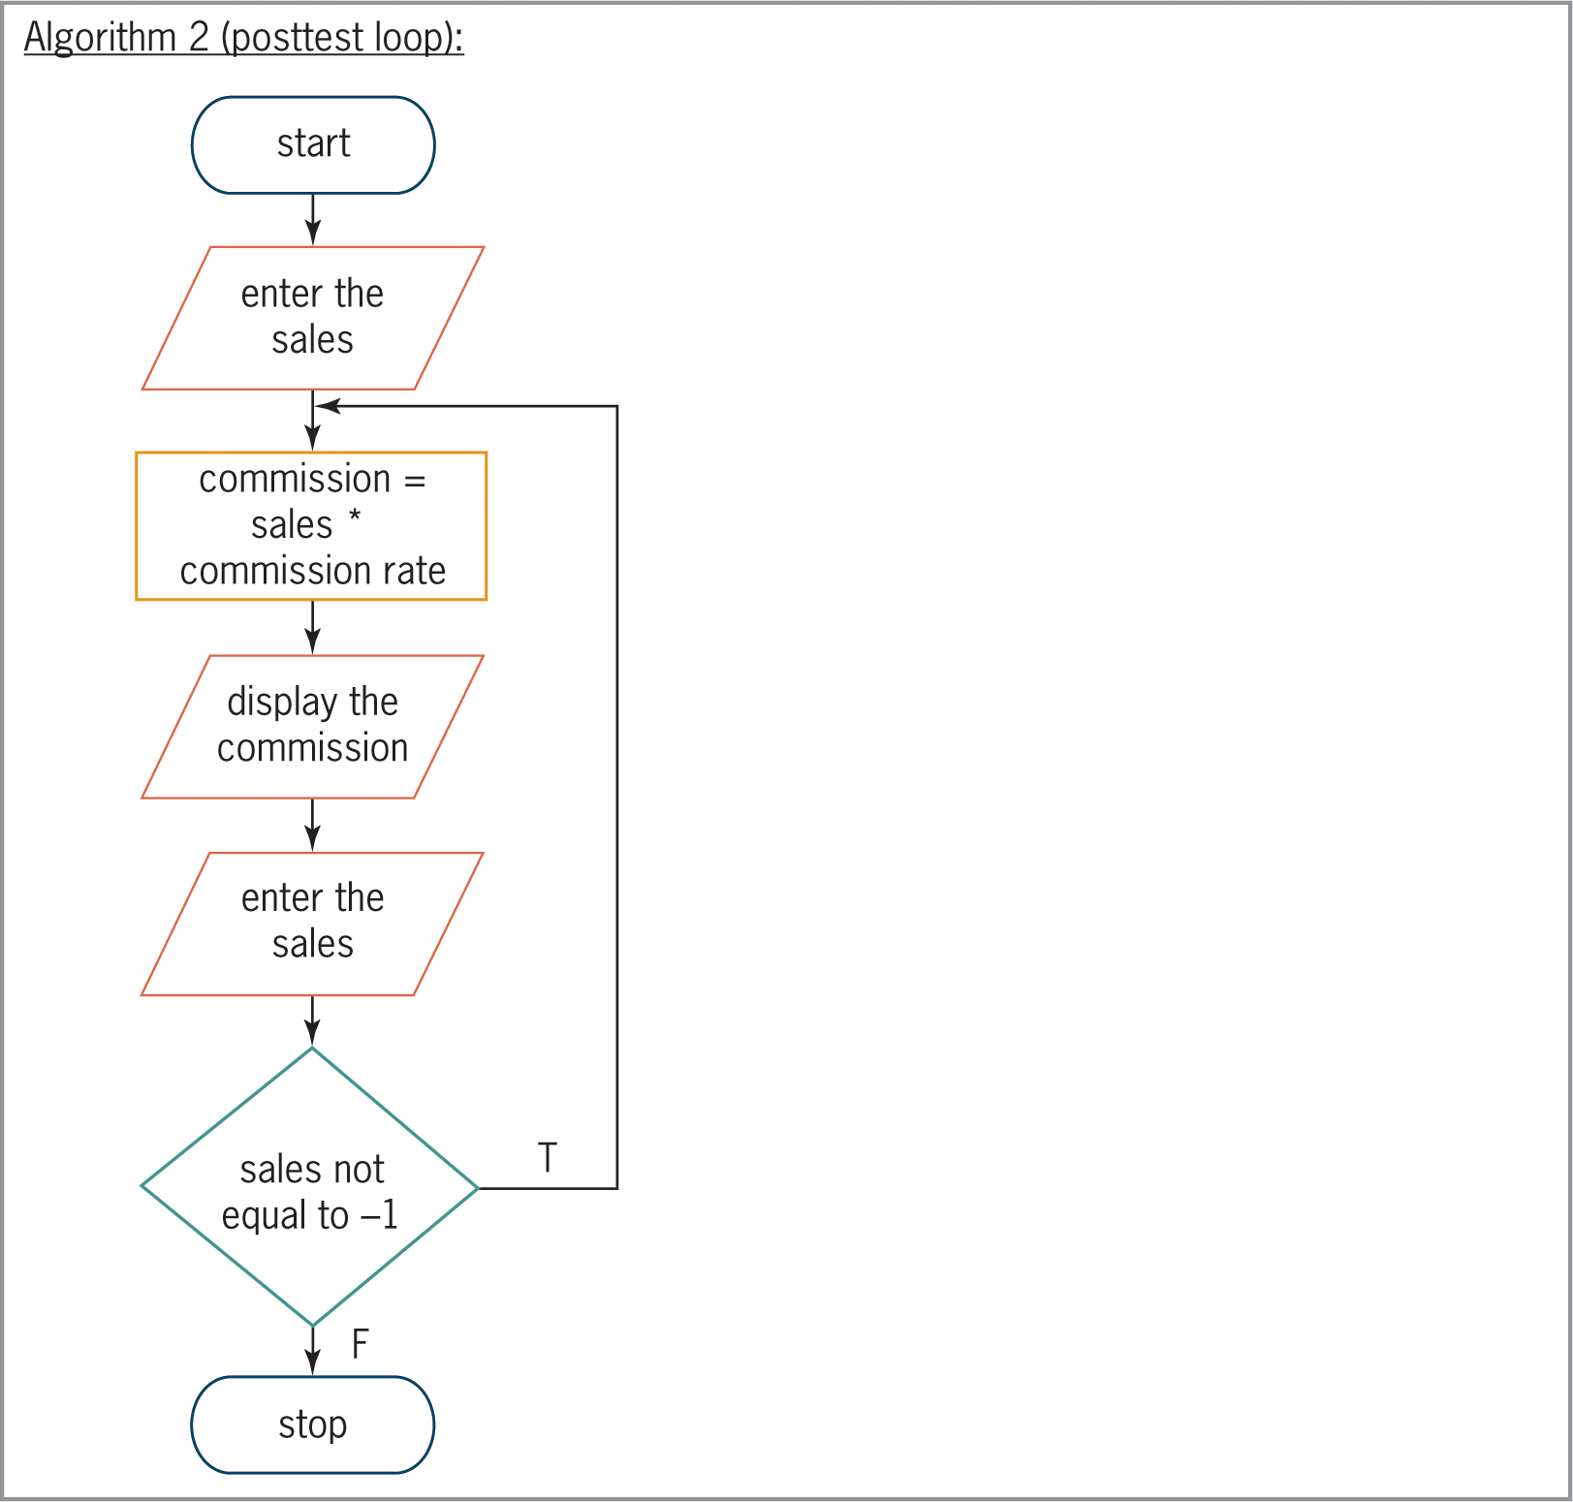
Flowcharting a Posttest Loop (cont’d.)
Figure 8-3 Commission Program’s problem specification and flowchart

Slide 9
The do while Statement
do while statement is used to code posttest loops in C++
Syntax:
do {
one or more statements to be processed one time,
and thereafter as long as the condition is true
} while (condition);
Some programmers use a comment (such as:
//begin loop) to mark beginning of loop

Slide 10
The do while Statement (cont’d.)
Programmer must provide loop condition
Must evaluate to a Boolean value
May contain variables, constants, functions, arithmetic operators, comparison operators, and logical operators
Programmer must also provide statements to be executed when condition evaluates to true
Braces are required around statements if there are more than one

Slide 11
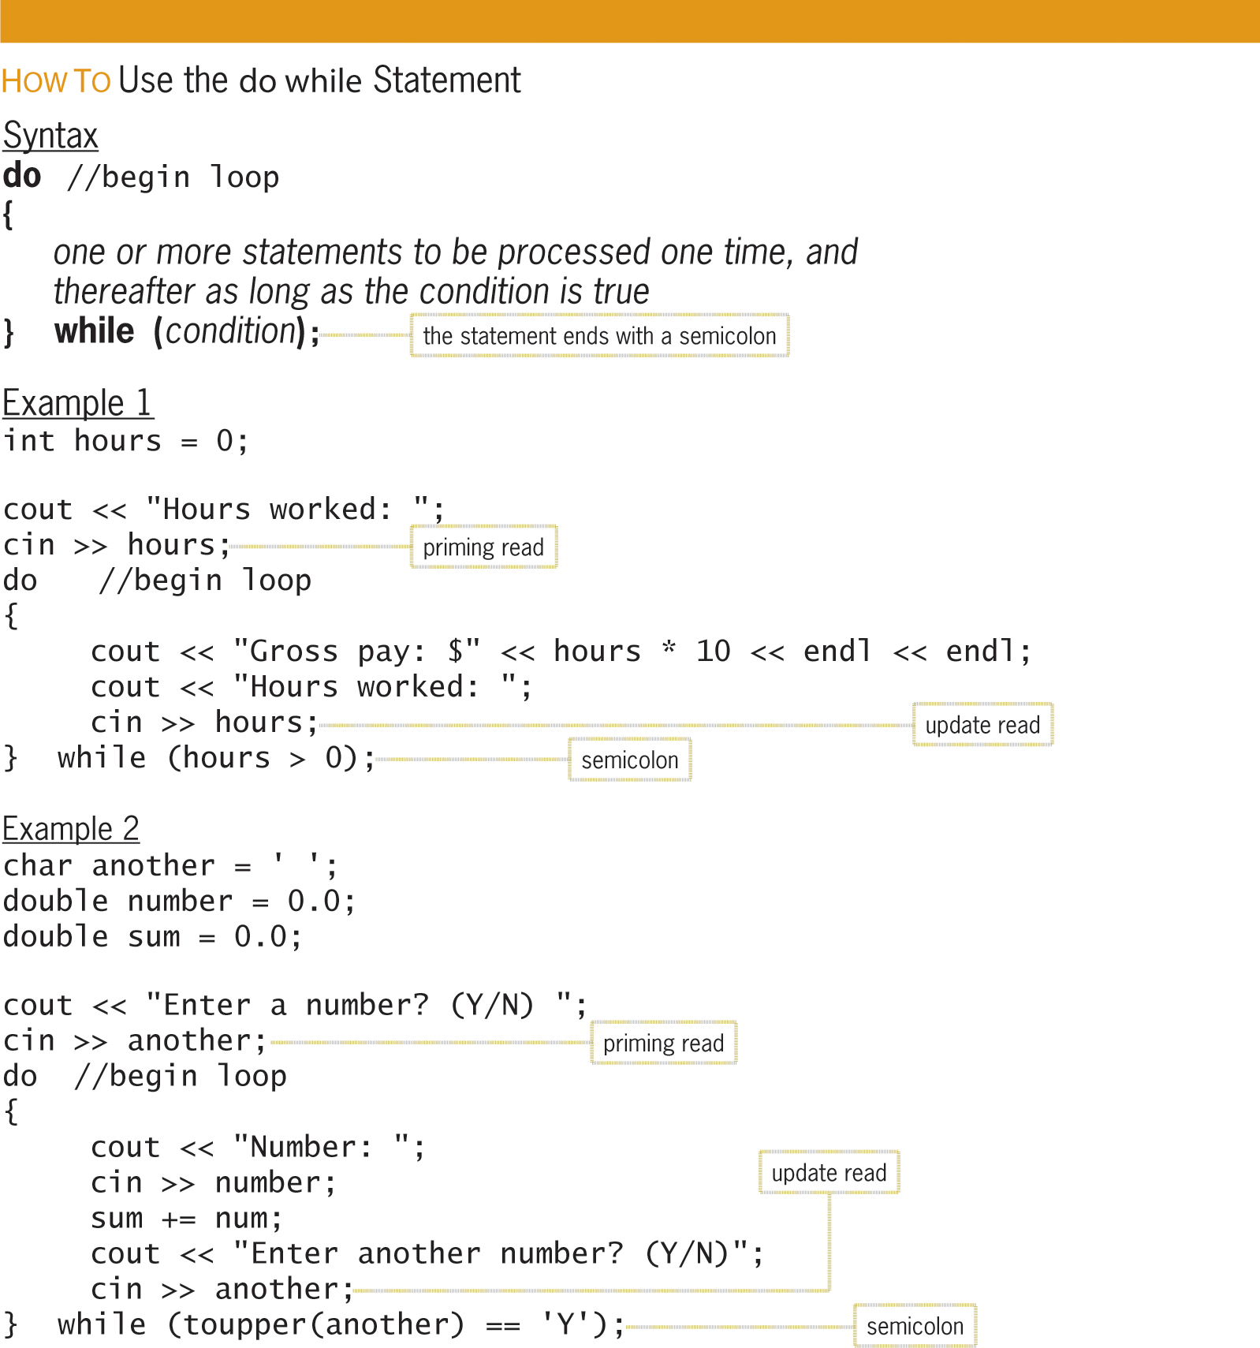
The do while Statement (cont’d.)
Figure 8-4 How to use the do while statement

Slide 12
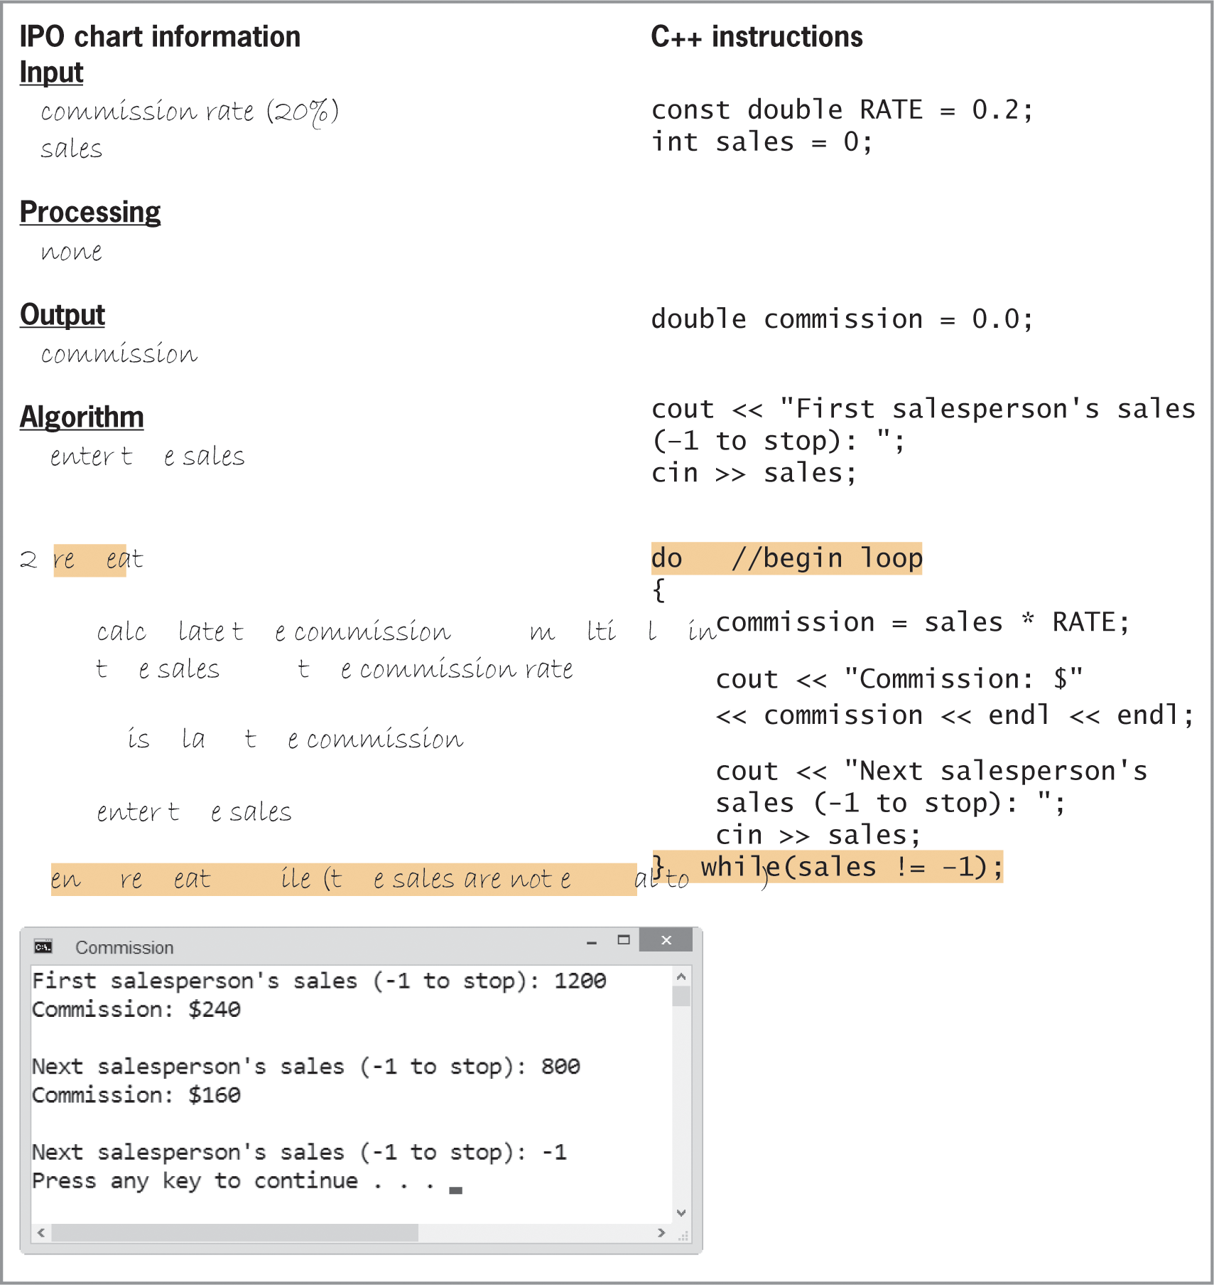
The do while Statement (cont’d.)
Figure 8-5 Commission Program containing a posttest loop

Slide 13
Nested Repetition Structures
Like selection structures, repetition structures can be nested
You can place one loop (the inner, or nested loop) inside another loop (the outer loop)
Both loops can be pretest loops or posttest loops, or the two loops may be different types
Programmer decides whether a problem requires a nested loop by analyzing the problem specification

Slide 14
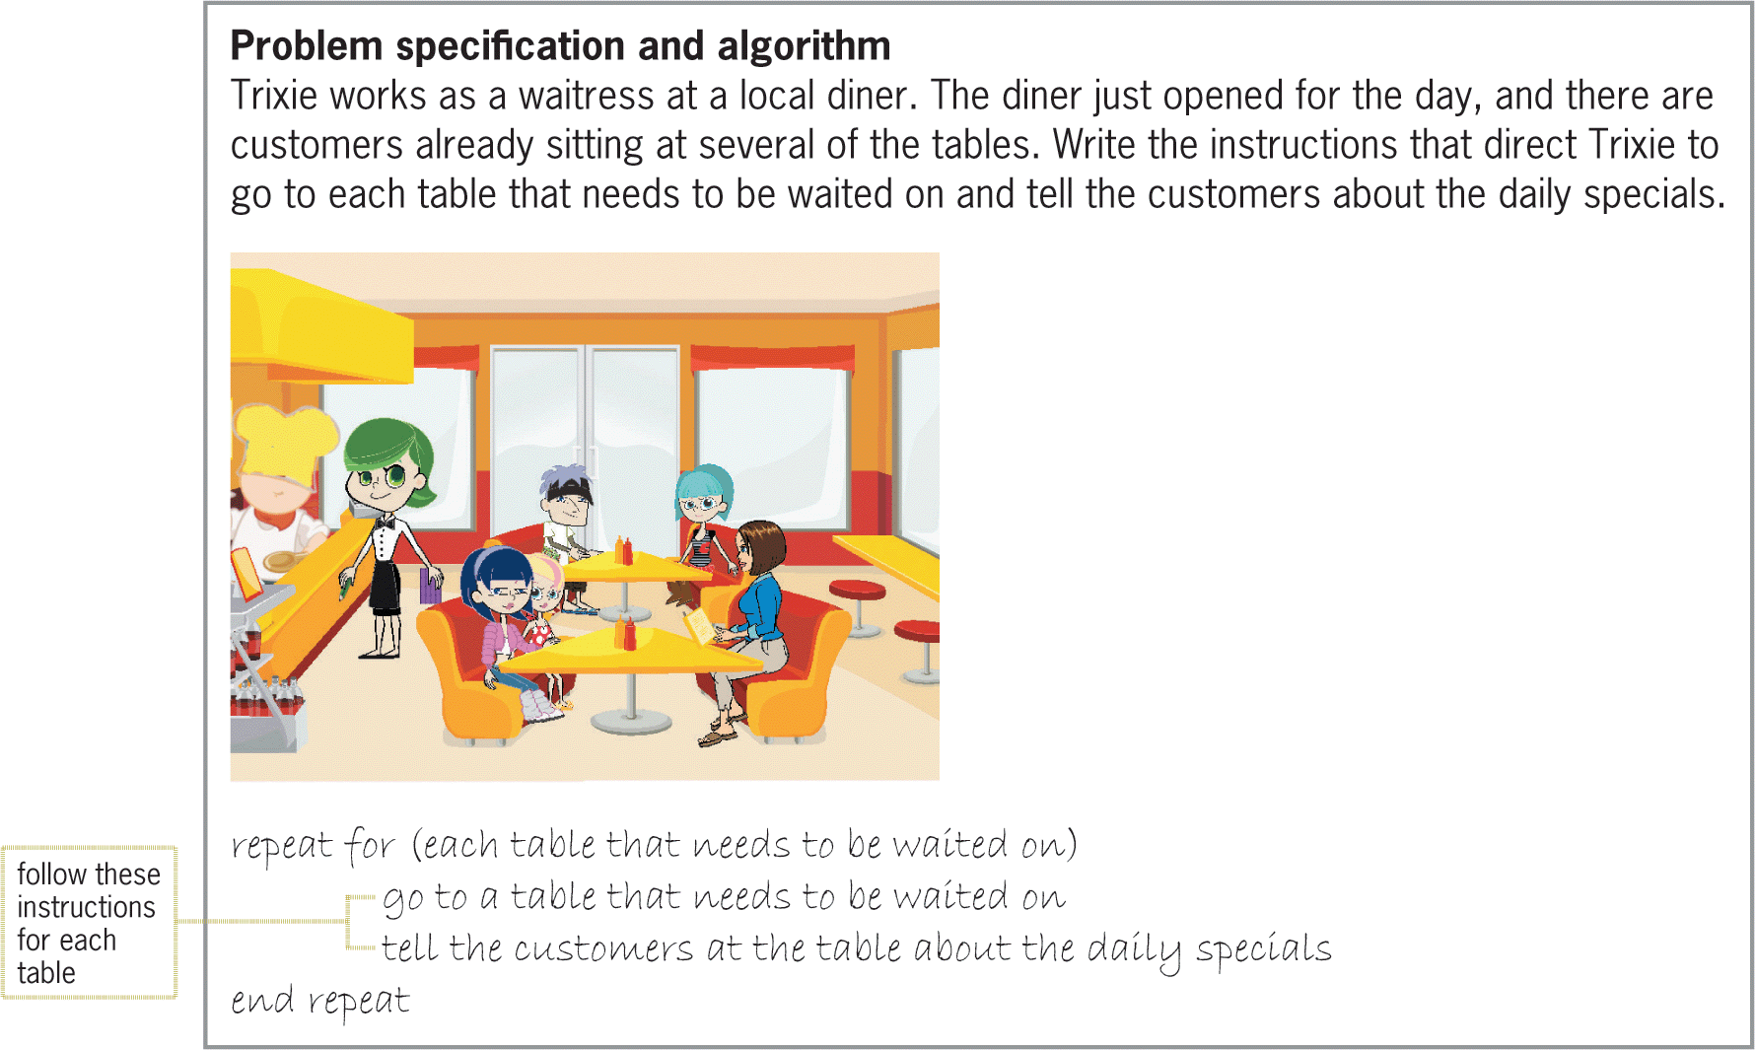
Nested Repetition Structures (cont’d.)
Figure 8-6 Problem specification and solution that requires a loop

Slide 15
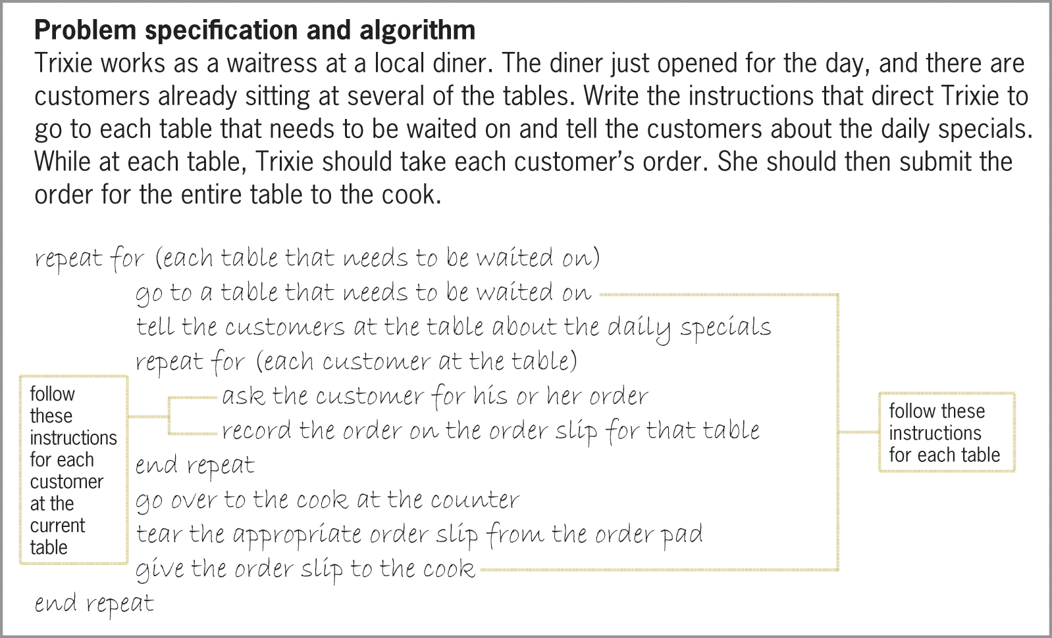
Nested Repetition Structures (cont’d.)
Figure 8-7 Modified problem specification and solution that requires a nested loop

Slide 16
The Clock Program
Simple program that simulates a clock with minutes and seconds.
The outer loop represents minutes.
The inner loop (nested loop) represents seconds.
To make it easier to desk-check the instructions, the nested loop uses only three seconds per minute and the outer loop stops after two minutes.

Slide 17
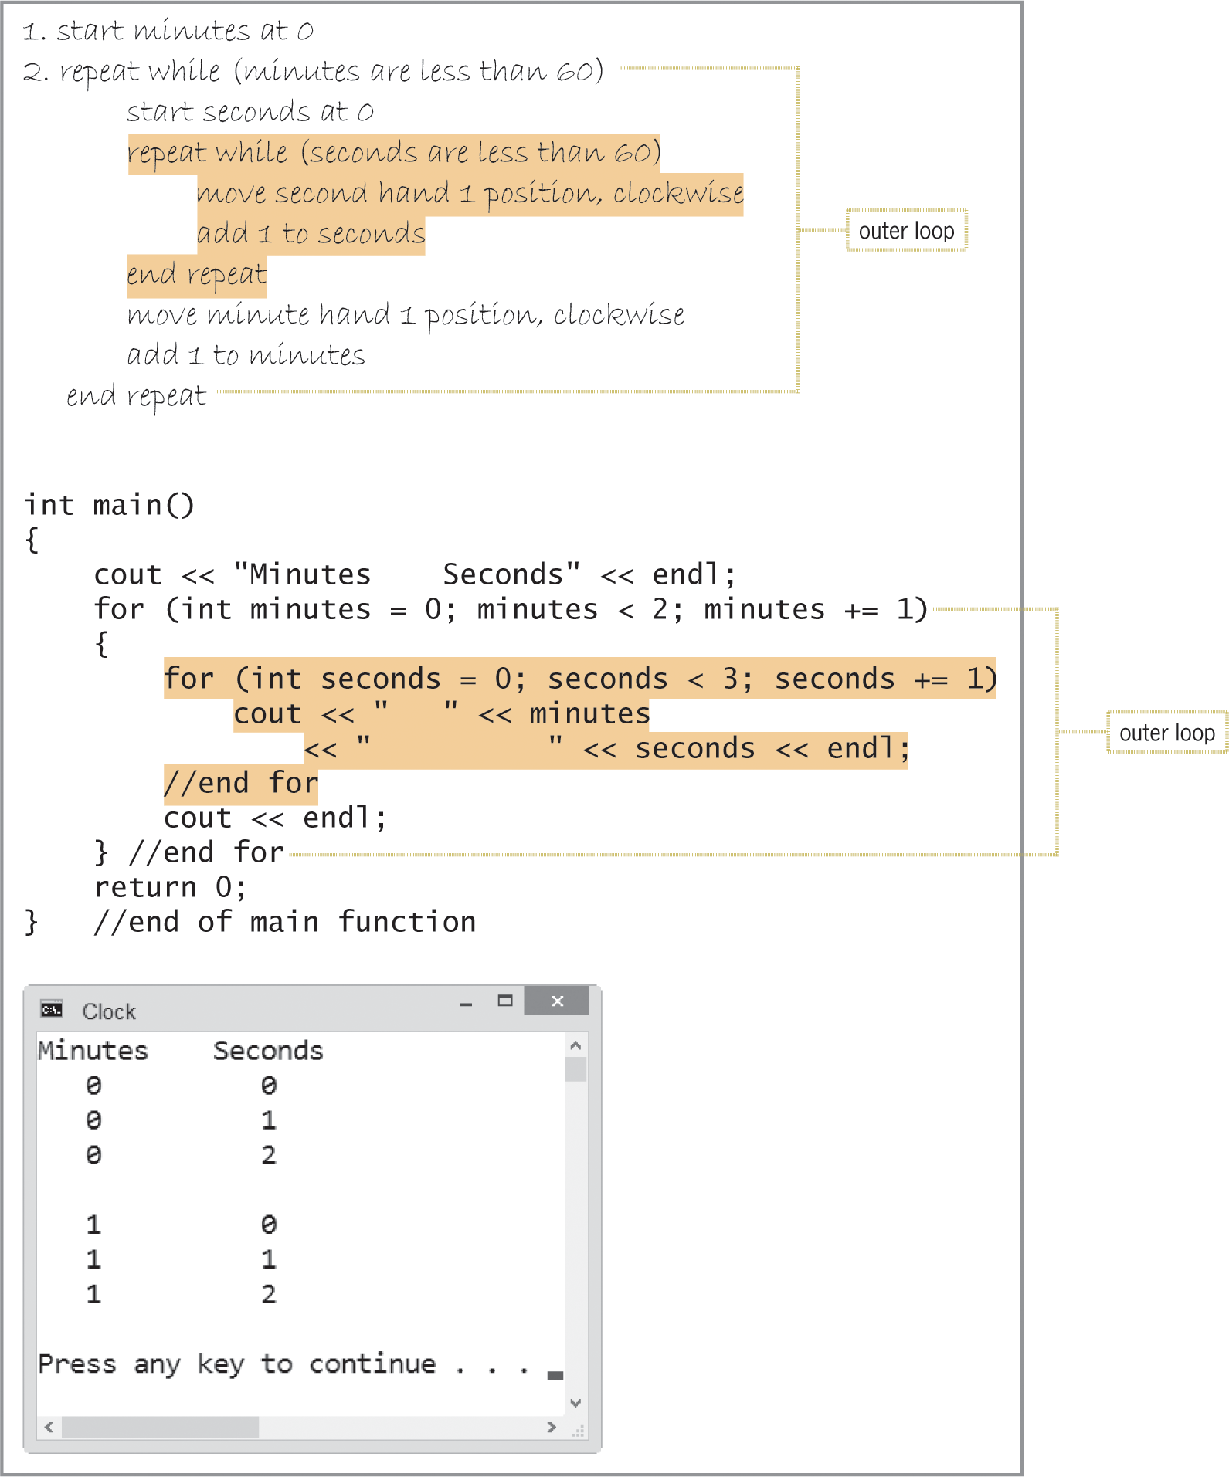
The Clock Program (cont’d.)
Figure 8-8 Algorithm, code, and a sample run of the Clock Program

Slide 18
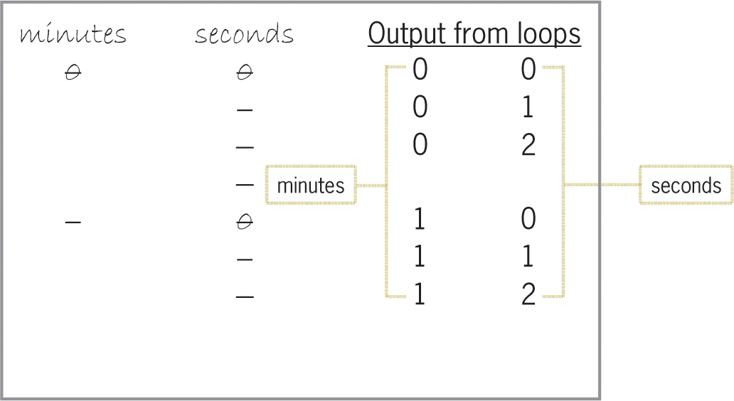
The Clock Program (cont’d.)
Figure 8-10 Completed desk-check table and output

Slide 19
The Car Depreciation Program
Calculate the depreciation of a car over time.
Program uses a counter-controlled loop to display the value of a new car at the end of each of five years, using a 15% annual depreciation rate.

Slide 20
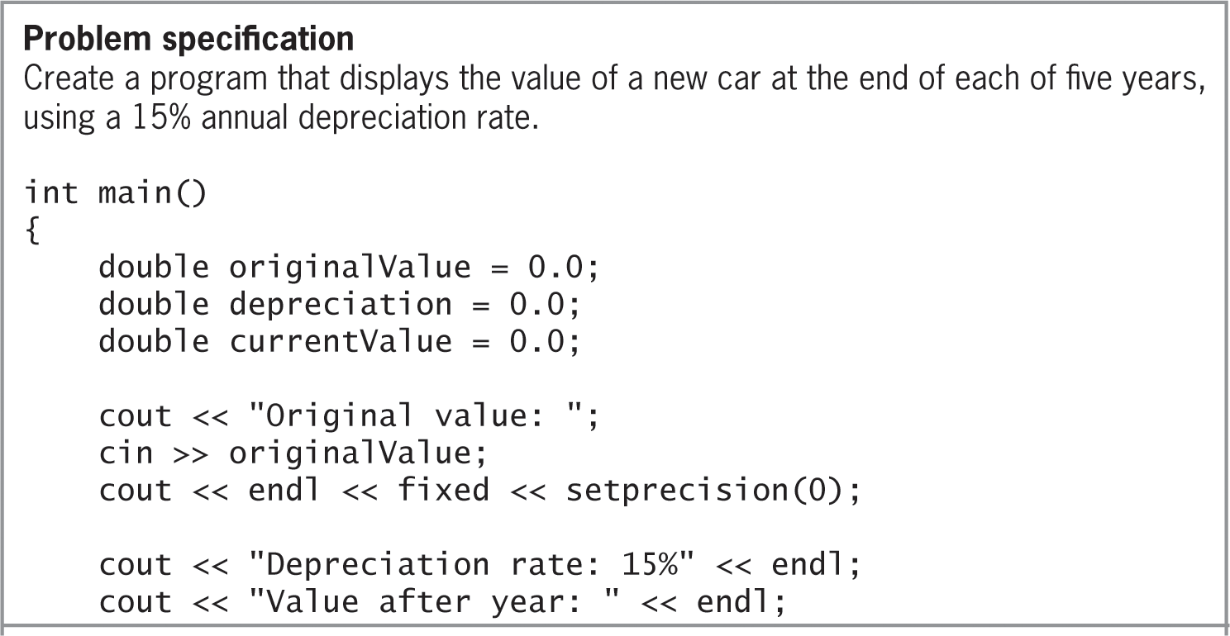
Car Depreciation Program (cont’d.)
Figure 8-11 Beginning of Car Depreciation Program with Problem Specification

Slide 21
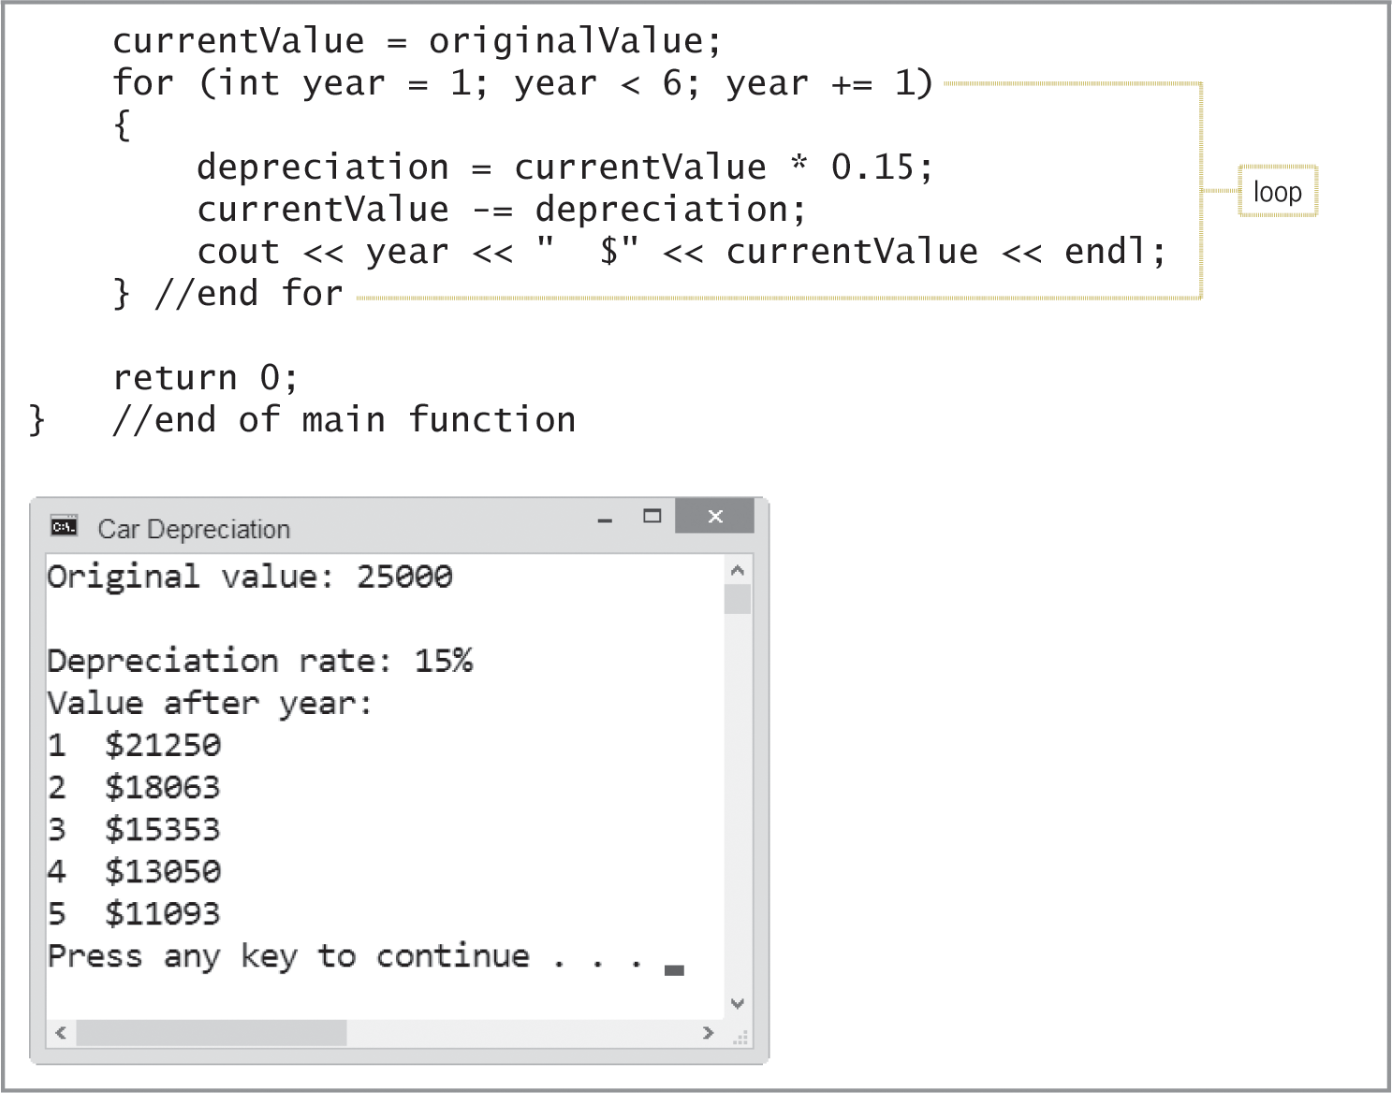
Car Depreciation Program (cont’d.)
Figure 8-11 Remainder of Car Depreciation Program with sample run

Slide 22
Car Depreciation Program (cont’d.)
Modify the Car Depreciation Program to use different depreciation rates.
This modified program displays the value of a new car at the end of each of five years, using annual depreciation rates of 15%, 20%, and 25%.

Slide 23
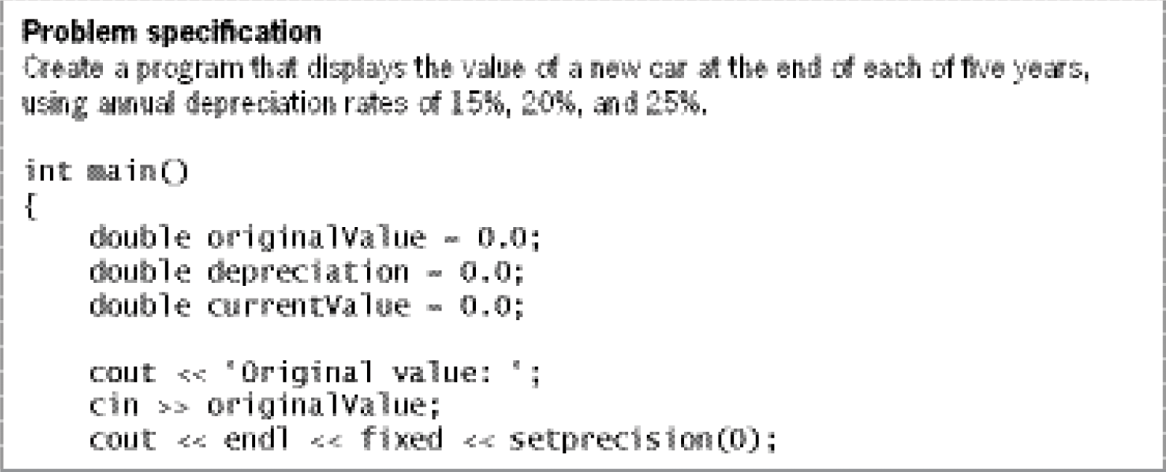
Car Depreciation Program (cont’d.)
Figure 8-12 Beginning of the modified Car Depreciation Program with problem specification

Slide 24
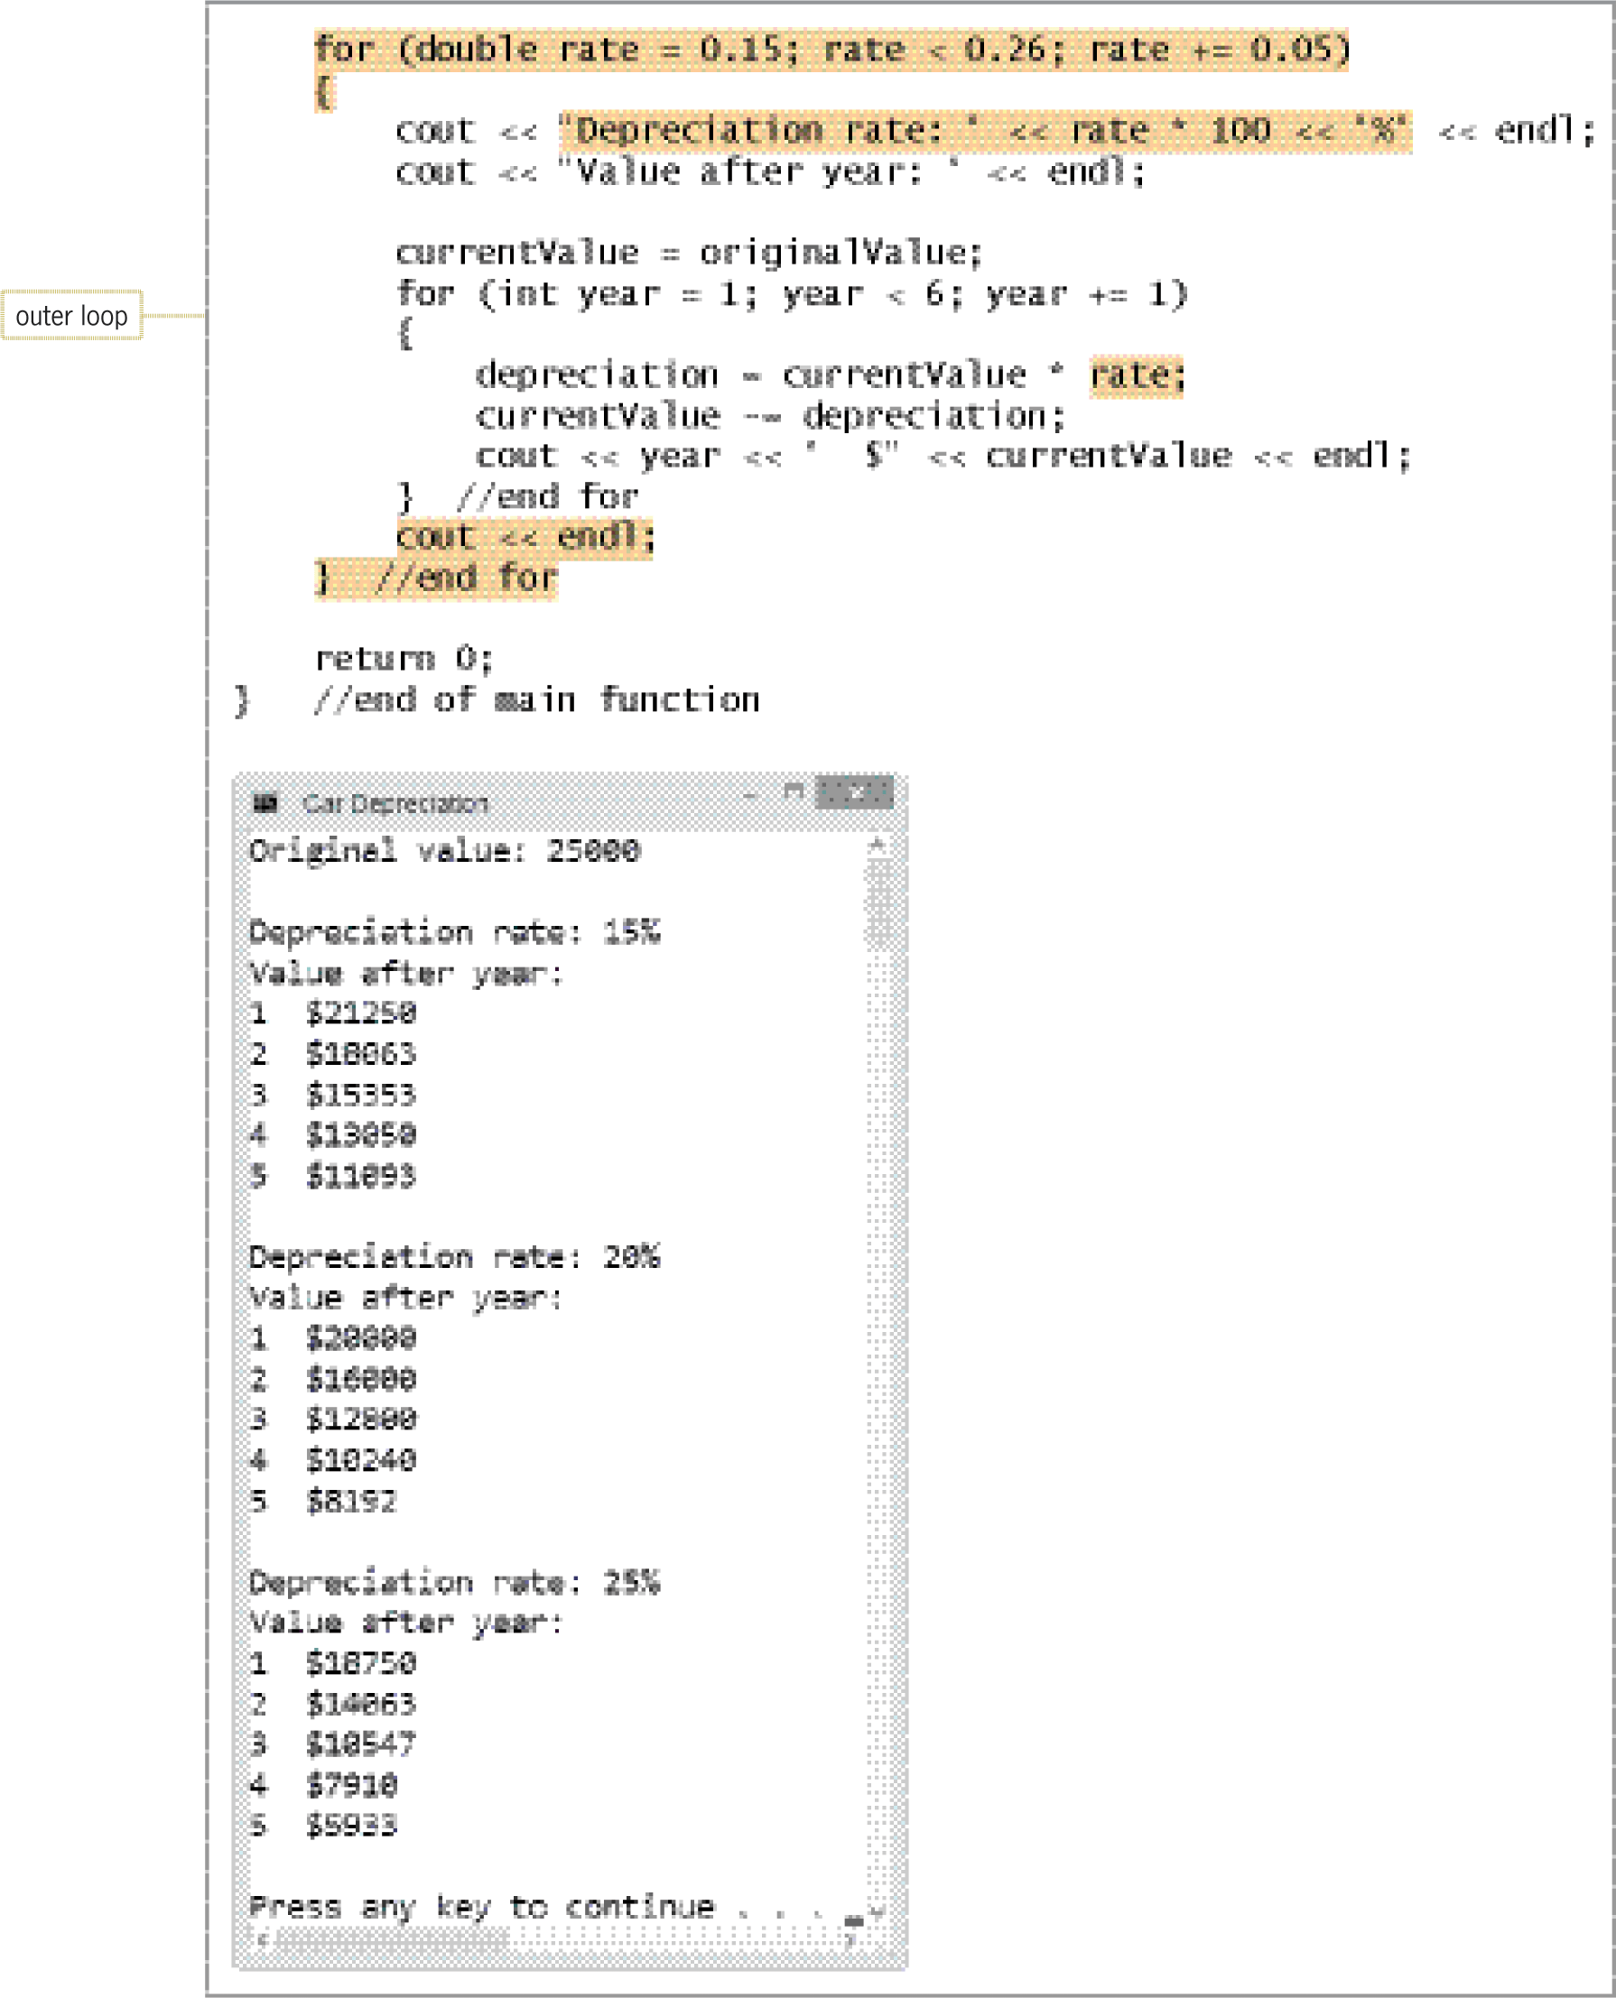
Car Depreciation Program (cont’d.)
Figure 8-12 Remainder of the modified Car Depreciation Program with sample run

Slide 25
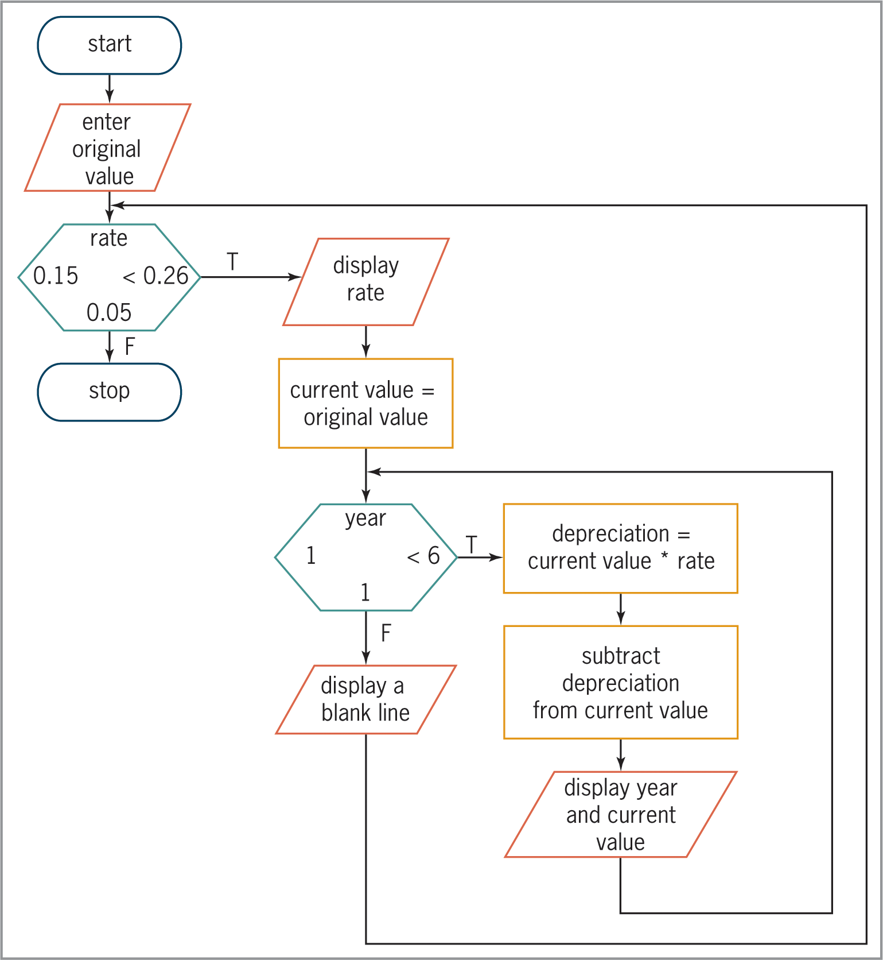
Car Depreciation Program (cont’d.)
Figure 8-13 Flowchart for the modified Car Depreciation Program

Slide 26
Summary
A repetition structure can be either a pretest loop or a posttest loop
In a pretest loop, the loop condition is evaluated before the instructions in the loop are processed
In a posttest loop, the evaluation occurs after the instructions within the loop are processed
Use the do while statement to code a posttest loop in C++
Use either the while statement or the for statement to code a pretest loop in C++

Slide 27
Summary (cont’d.)
Repetition structures can be nested, which means one loop (called the inner or nested loop) can be placed inside another loop (called the outer loop)
For nested repetition structures to work correctly, the entire inner loop must be contained within the outer loop

Slide 28
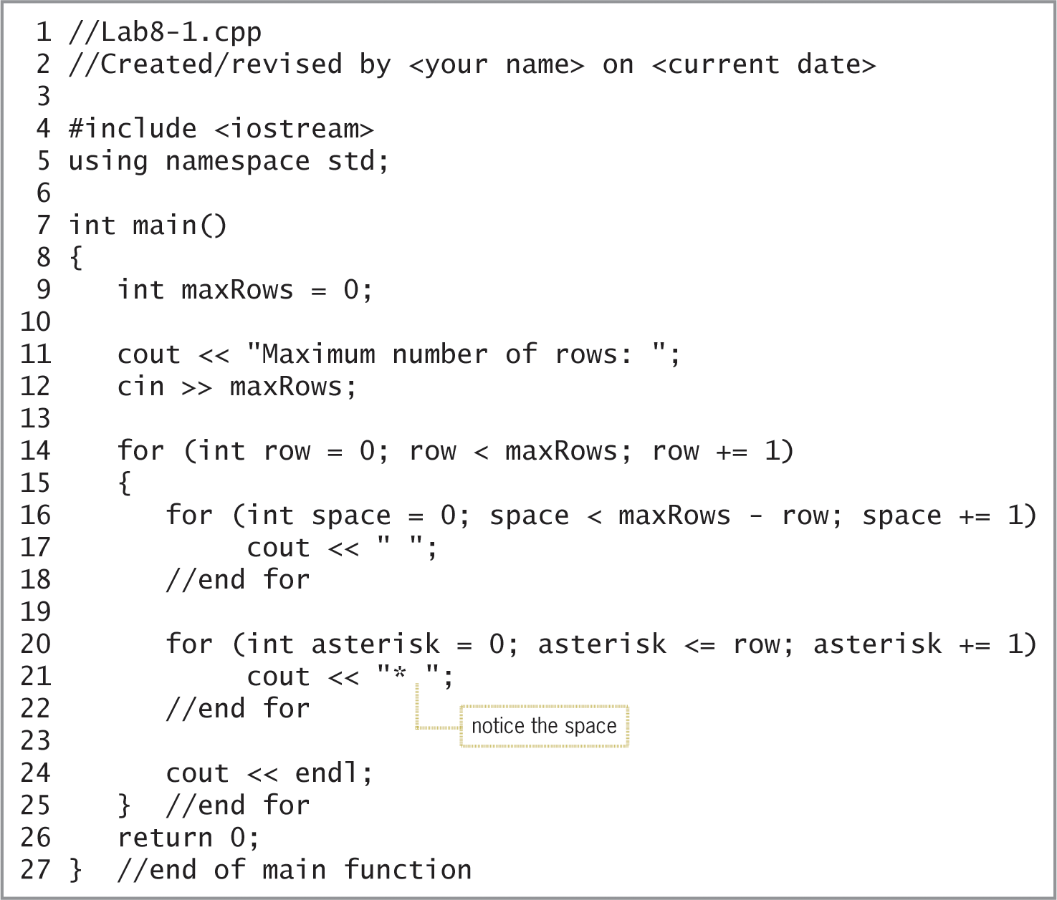
Lab 8-1: Stop and Analyze
Study the program below and answer the questions.
Figure 8-14 Code for Lab 8-1

Slide 29
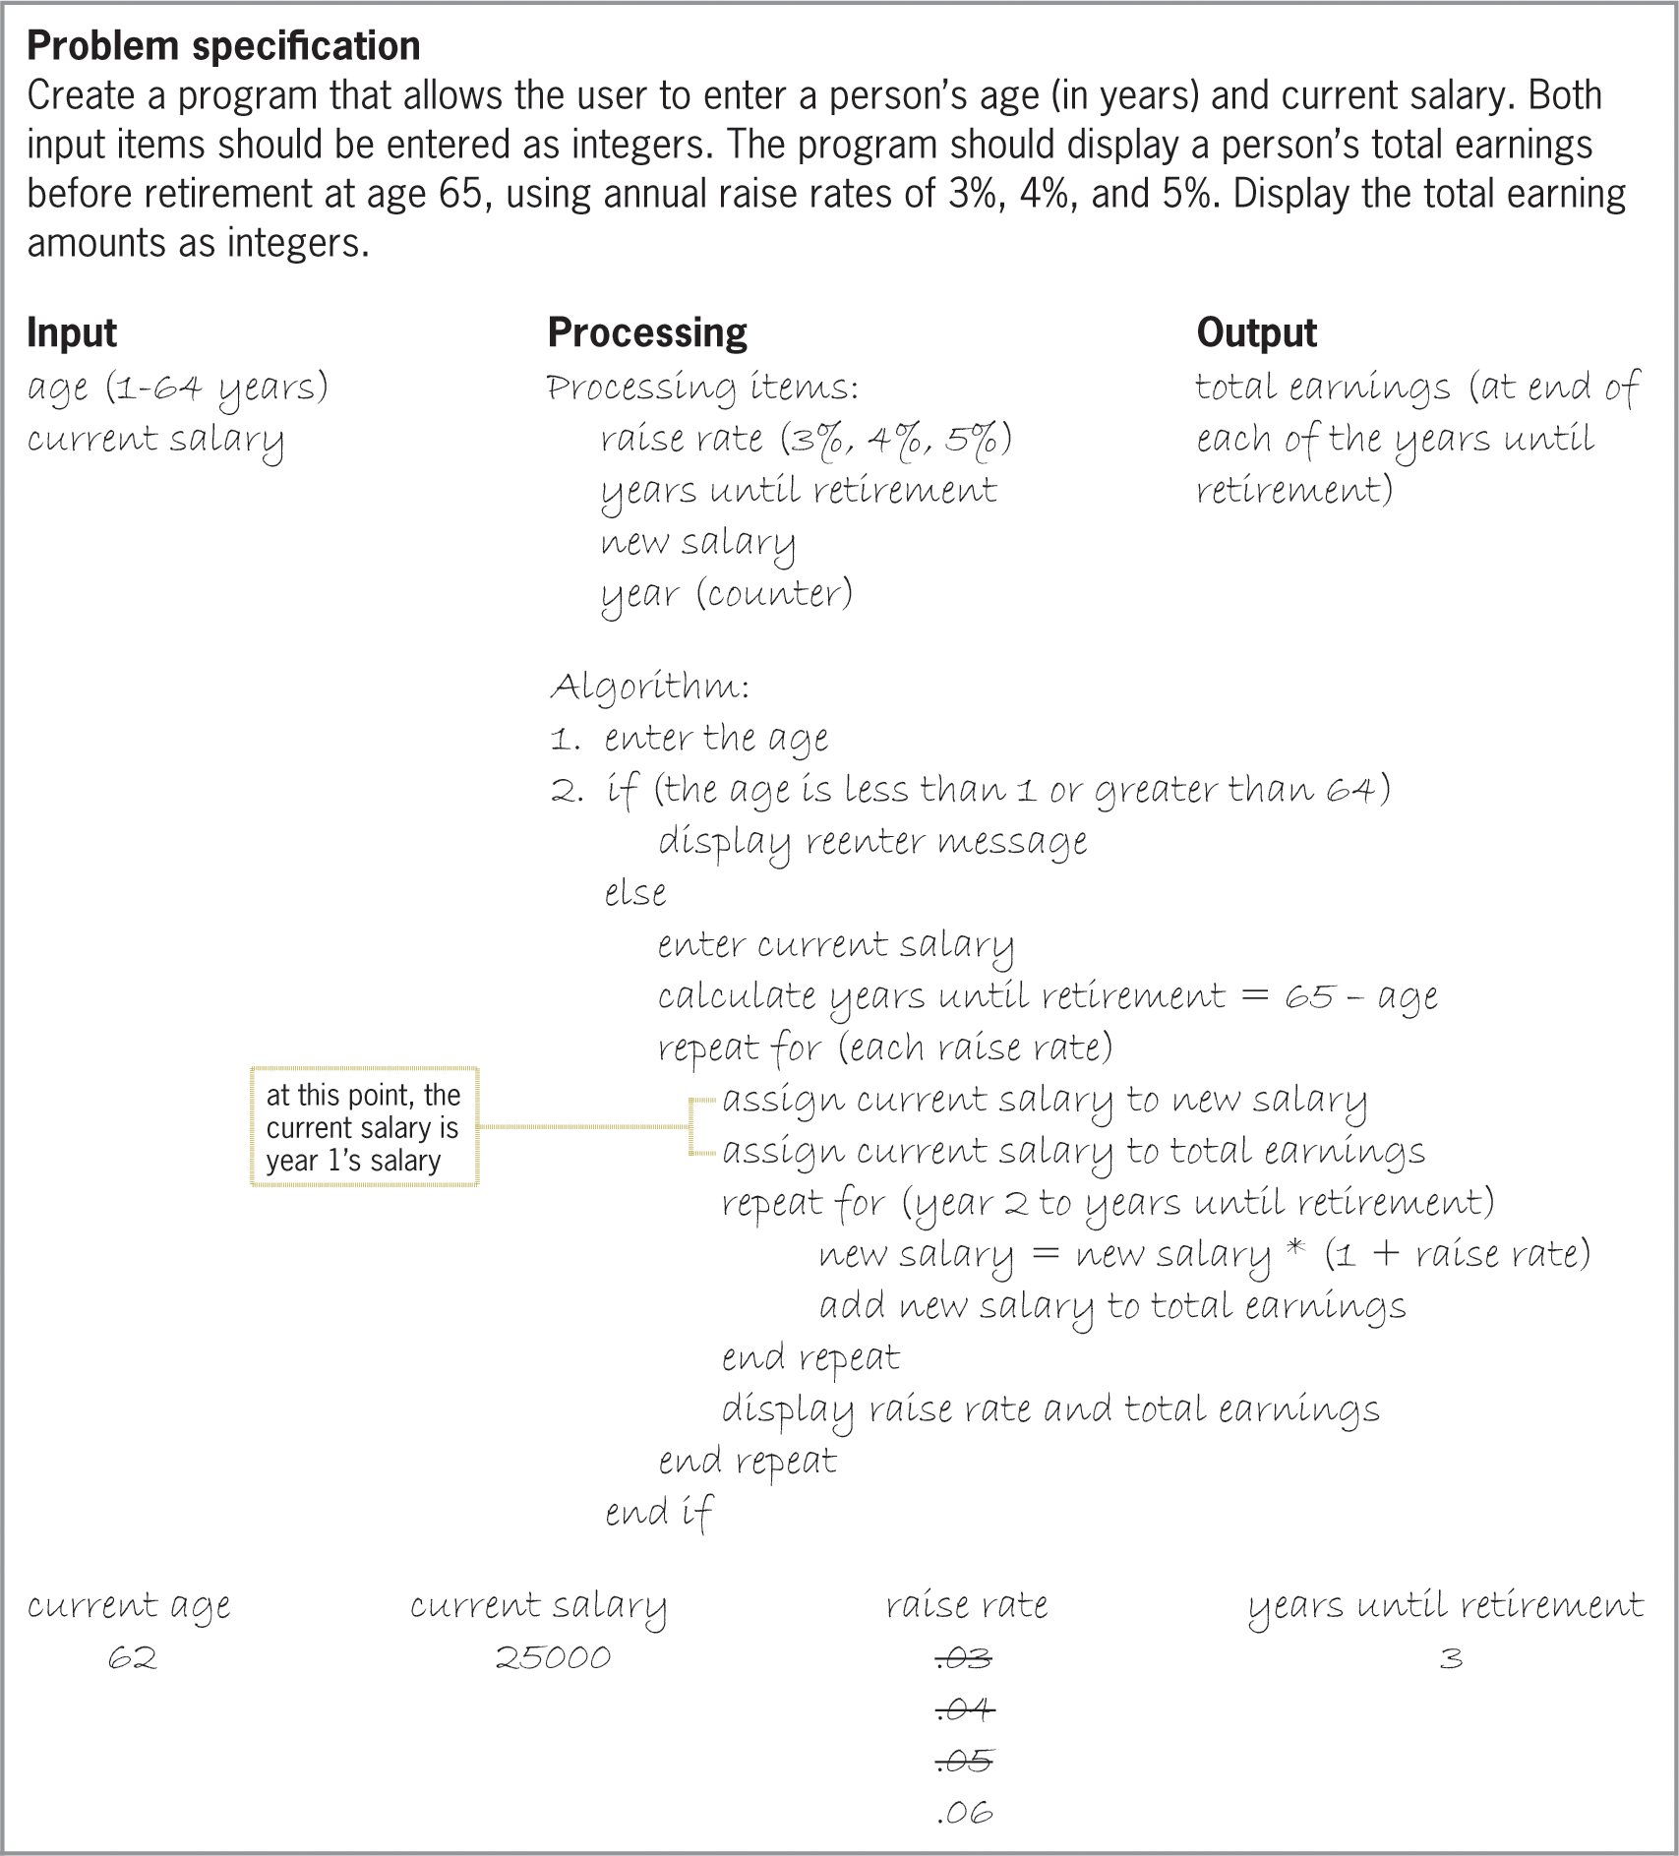
Lab 8-2: Plan and Create
Figure 8-15 Problem specification, IPO chart, and desk-check table for the Retirement program

Slide 30
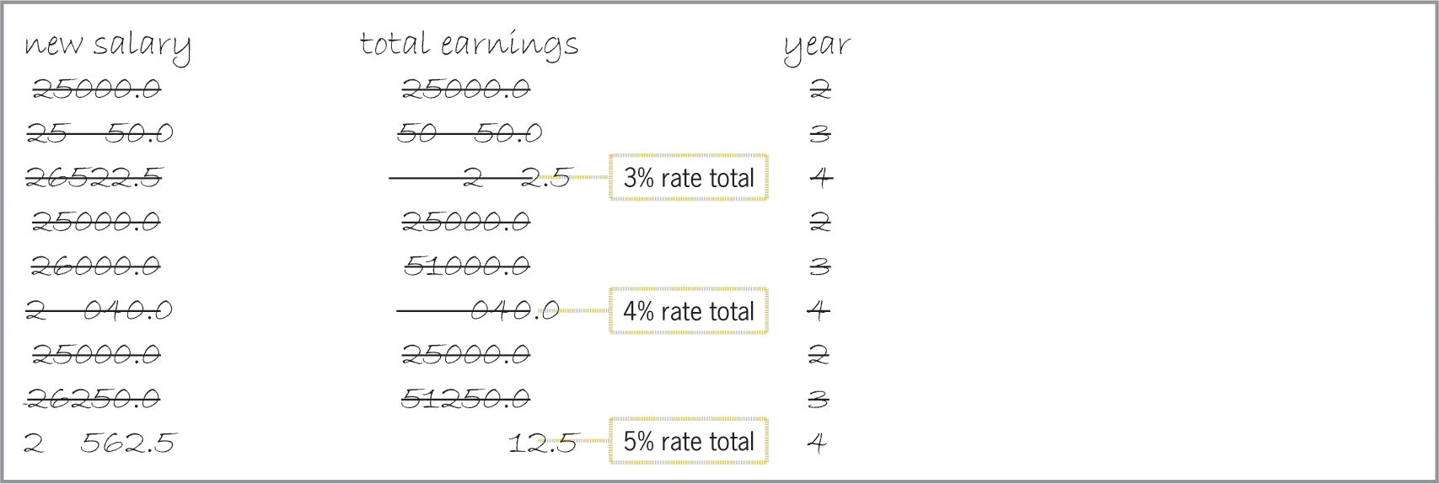
Lab 8-2: Plan and Create (cont’d.)
Figure 8-15 Remainder of the desk-check table for the Retirement program

Slide 31
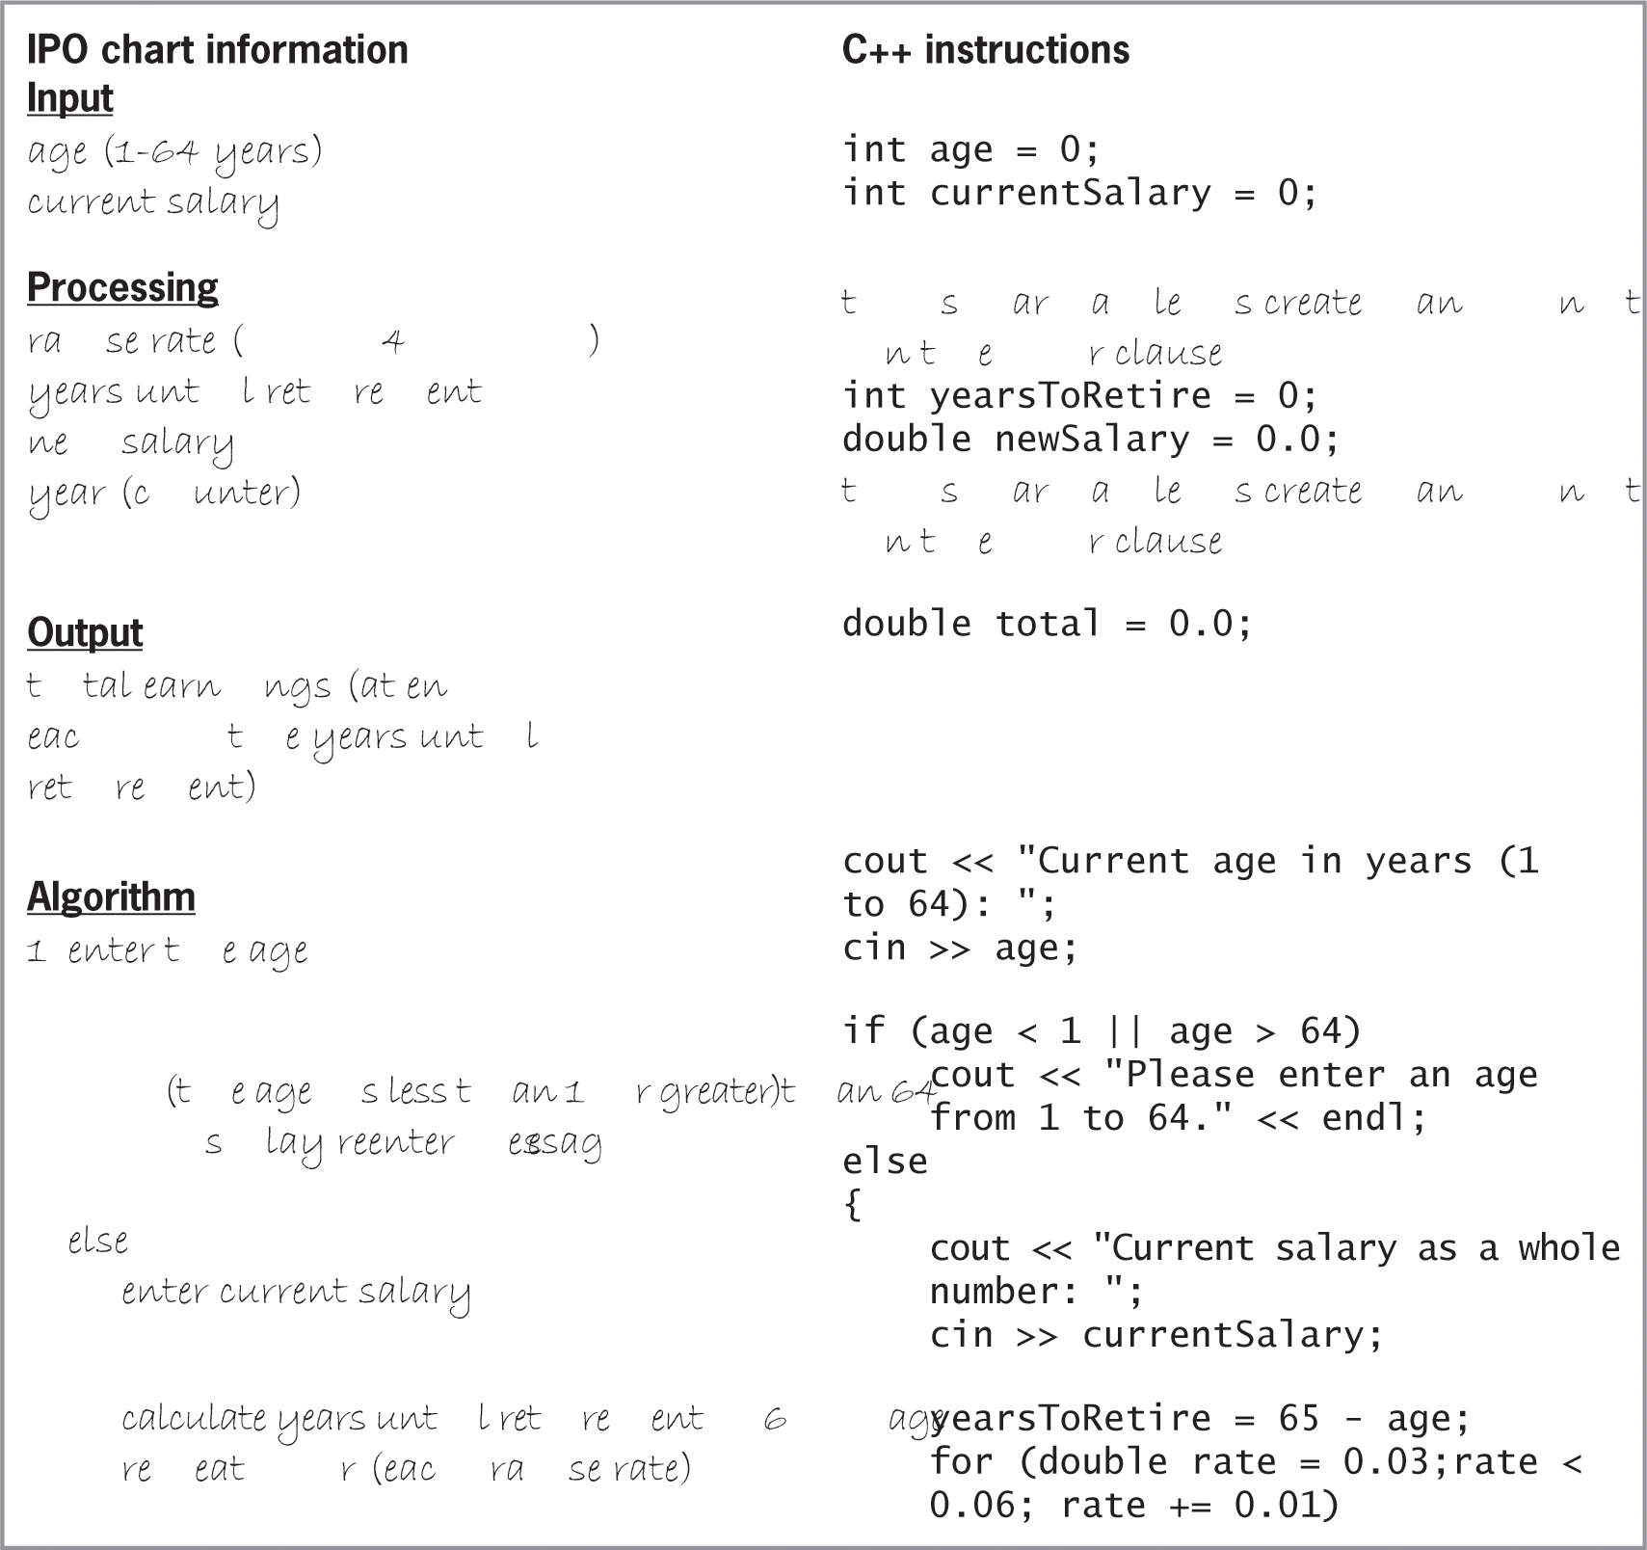
Lab 8-2: Plan and Create (cont’d.)
Figure 8-16 Beginning of the IPO chart information and C++ instructions for the Retirement program

Slide 32
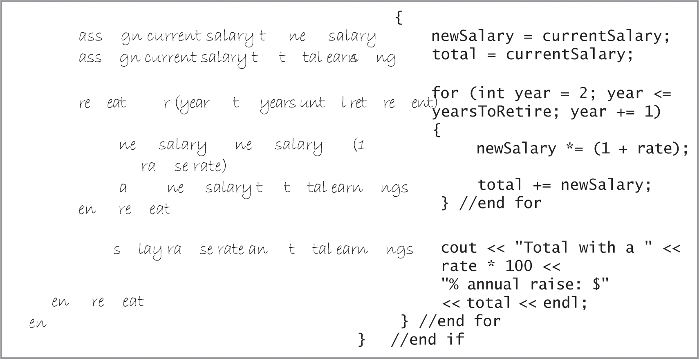
Lab 8-2: Plan and Create (cont’d.)
Figure 8-16 Remainder of the IPO chart information and C++ instructions for the Retirement program

Slide 33
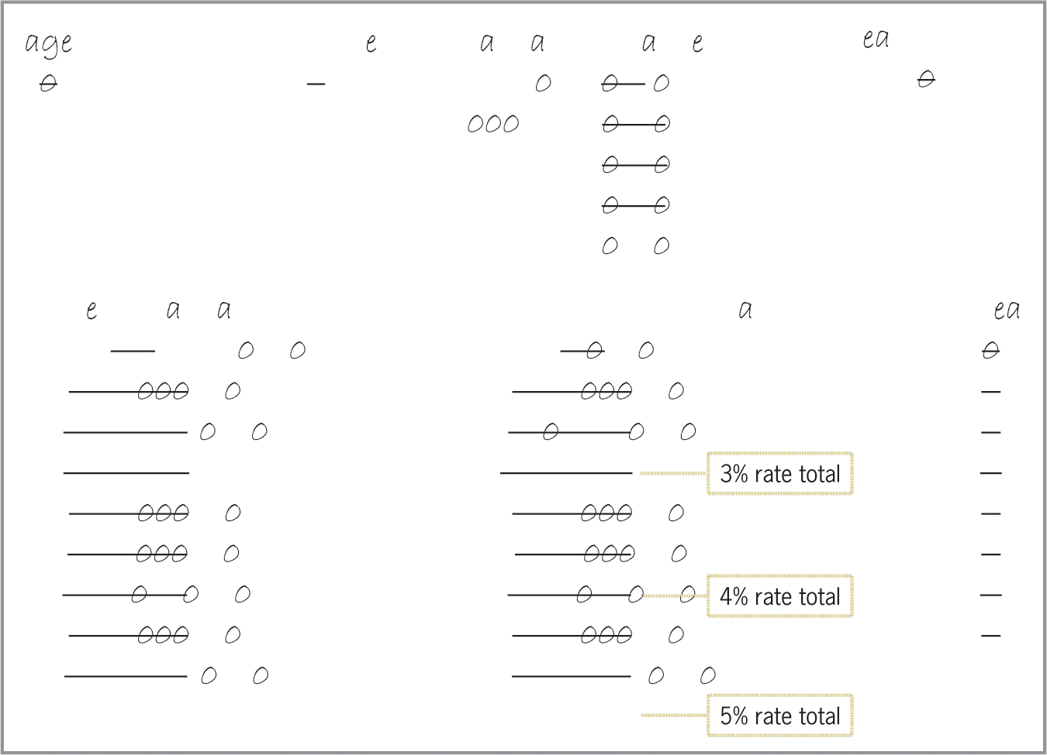
Lab 8-2: Plan and Create (cont’d.)
Figure 8-17 Desk-check table for the Retirement program

Slide 34
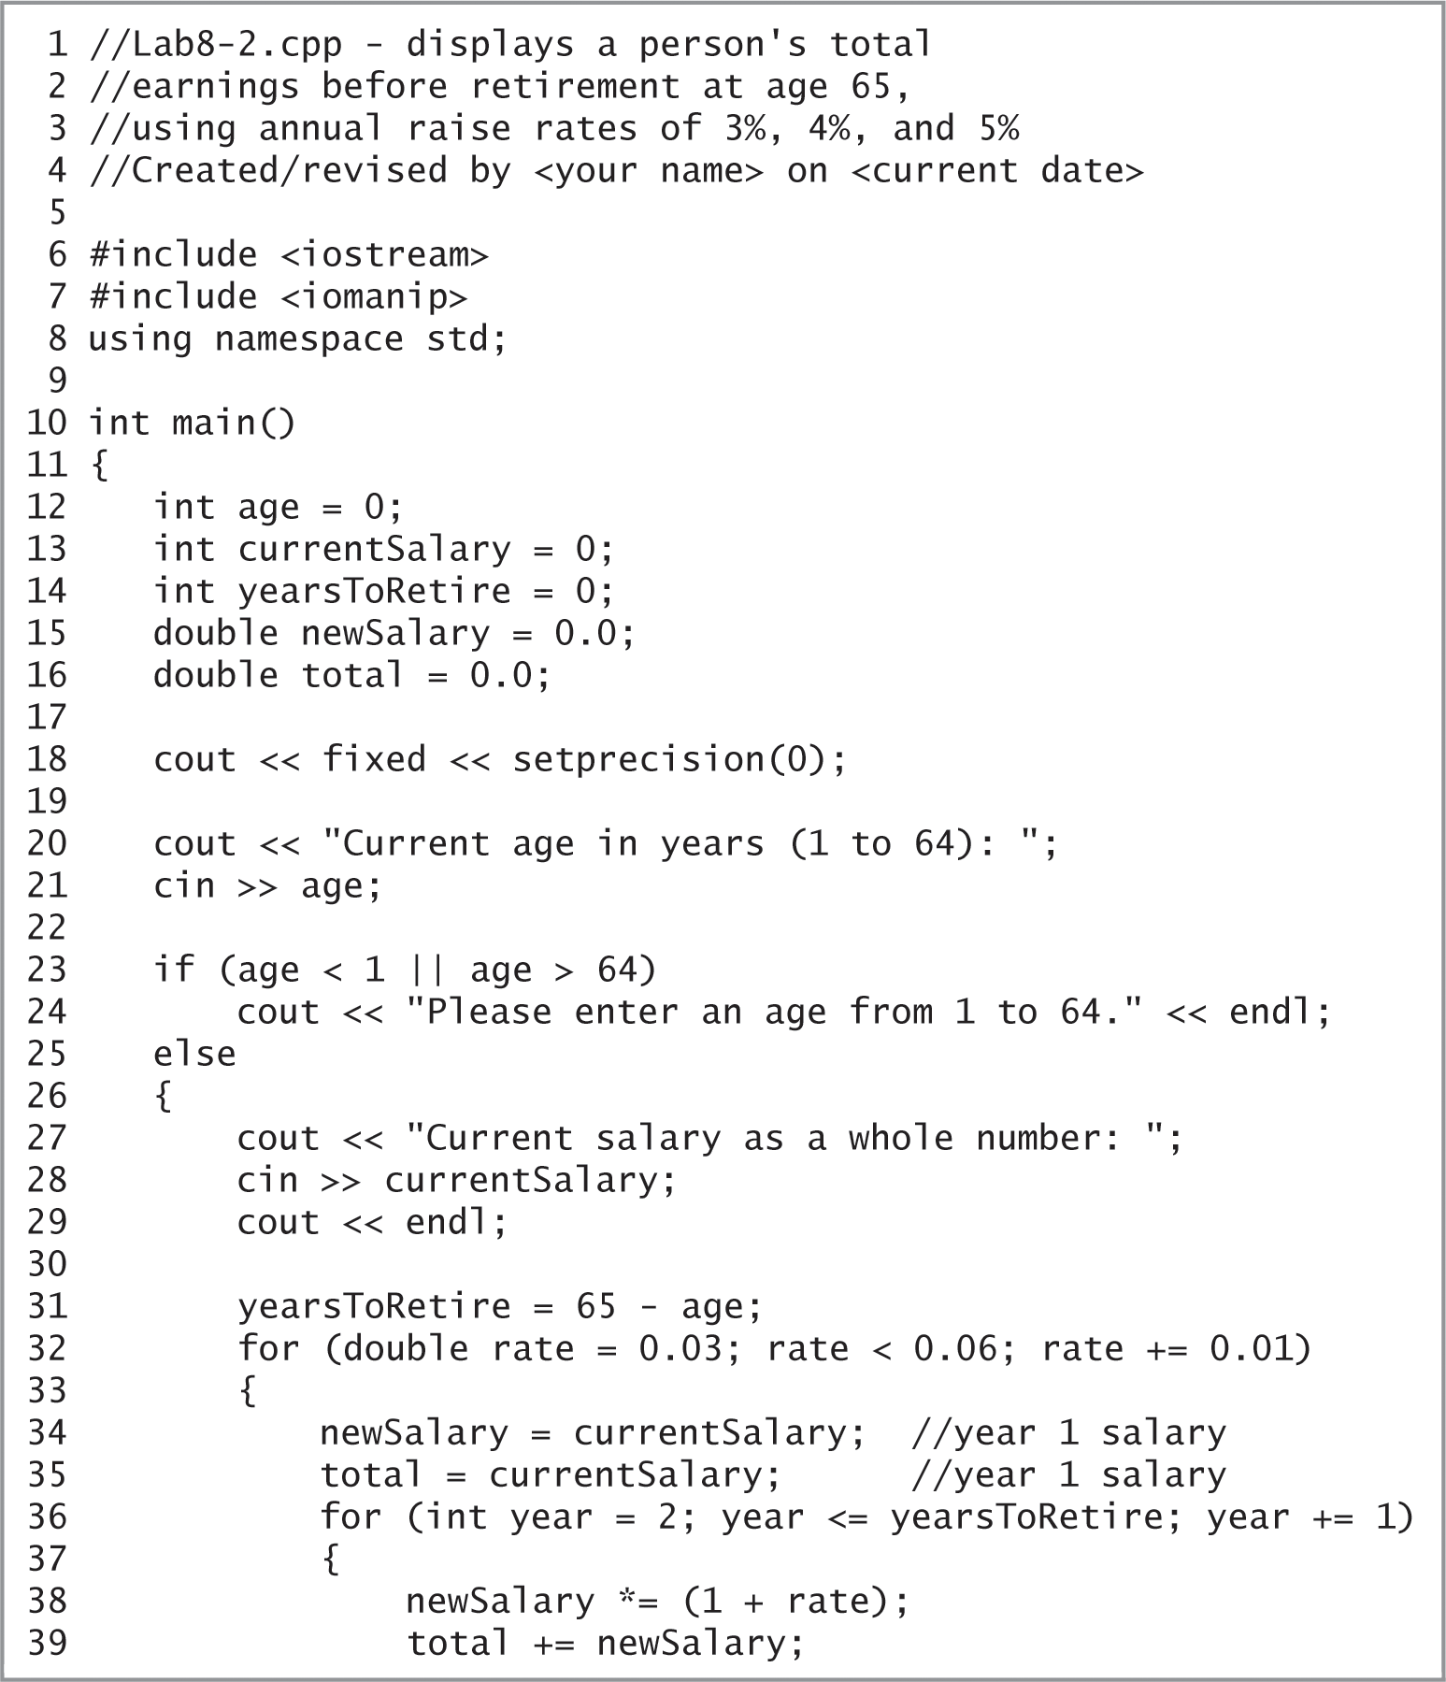
Lab 8-2: Plan and Create (cont’d.)
Figure 8-18 Beginning of the finalized Retirement program

Slide 35
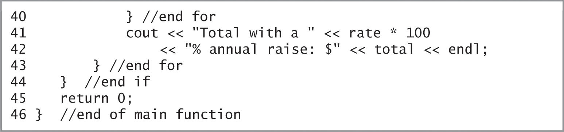
Lab 8-2: Plan and Create (cont’d.)
Figure 8-18 Remainder of the finalized Retirement program

Slide 36
Lab 8-3: Modify
Modify the program in Lab8-2.cpp. Change the outer for loop to a posttest loop. Save the modified program as Lab8-3.cpp
Save, run, and test the program.

Slide 37
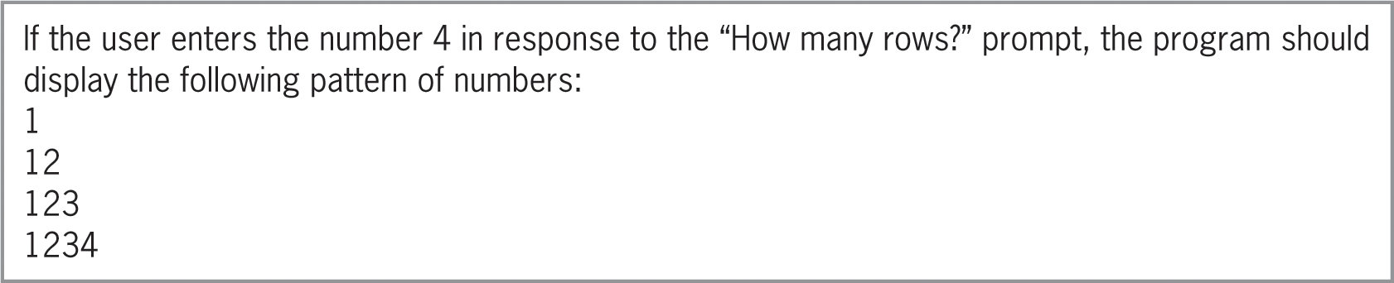
Lab 8-4: What’s missing?
The program is this lab should display the pattern of numbers shown in Figure 8-19 below.
Follow the instructions for starting C++ and opening the Lab8-4.cpp file. Put the C++ instructions in the proper order, and then determine the one or more missing instructions.
Test the program appropriately.
Figure 8-19 Sample output for Lab 8-4

Slide 38
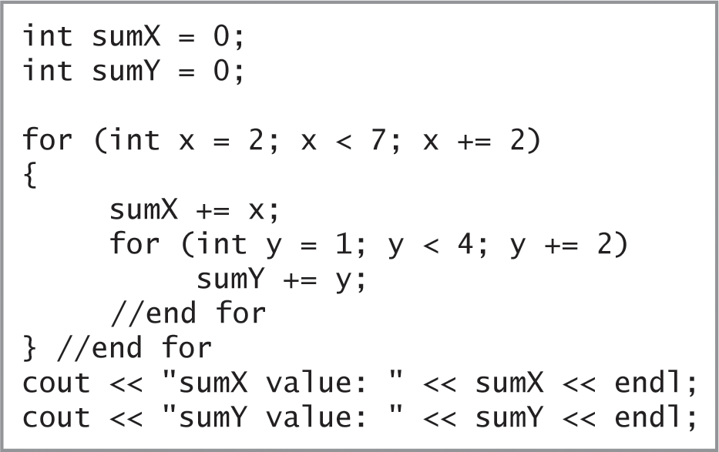
Lab 8-5: Desk-Check
Desk-check the code in Figure 8-20
What will the code display on the computer screen?
Figure 8-20 Code for Lab 8-5

Slide 39
Lab 8-6: Debug
Follow the instructions for starting C++ and opening the Lab8-6.cpp file.
The program should display a store’s quarterly sales, but it is not working properly.
Debug the program.

